Slide 1
Queue

Slide 2
Queue- A queue is a linear list of elements in which insertions can take place at one end called the rear of the queue, and deletion can take place only at other end, called the font of the queue. Queues are also called the FIFO lists (First In First Out) since first element in queue is the first element out of the queue. An important example of a queue in computer science occurs in time sharing systems in which programs with same priority form a queue while waiting to be executed.
Queues may be represented in computer in various ways, usually by means of one-way lists or linear arrays

Slide 3
Representing a Queue Using an Array
A Queue is maintained by a linear array queue and two pointer variables: FRONT, containing the location of front element of the queue and REAR, containing the location of rear element of the queue. The condition FRONT=NULL indicates that queue is empty. Whenever an element is deleted from the queue, the value of FRONT is increased by 1. Similarly, whenever an element is added to queue, the value of REAR is increased by 1.
Queue as a circular queue
It can be seen that after N insertions in a Queue represented by an array of N elements, the rear element of Queue will occupy last part of array. This occurs even though the queue itself may not contain many elements. Now, if we want to insert an element ITEM into a queue, we have to move or rearrange the elements of entire queue to the beginning of the queue. This procedure may be very expensive. Another method to do so is to represent a queue as a circular queue i,e QUEUE[1] comes after QUEUE[N] in array. With this assumption, we insert ITEM into queue by assigning ITEM to QUEUE[1]. Thus instead of increasing REAR to N+1, we reset REAR=1 and then assign
QUEUE[REAR]=ITEM
Similarly, If FRONT=N and an element of QUEUE is deleted, we reset FRONT=1 instead of increasing FRONT to N+1

Slide 4
Algorithm for Inserting in a QUEUE
Algorithm: QINSERT(QUEUE, N, FRONT, REAR,ITEM)
This algorithm inserts an element in a linear queue
Step 1:[Queue already filled]
If REAR=N, then:
Write: ‘OVERFLOW’
Exit
Step 2: If FRONT=NULL, then: [Queue initially empty]
Set FRONT:=1 and REAR:=1
Else:
Set REAR:=REAR+1
[End of If structure]
Step 3: Set QUEUE[REAR]:=ITEM
Step 4: Return

Slide 5
Algorithm: QDELETE(QUEUE,N,FRONT,REAR,ITEM)
This algorithm deletes an element from a queue
Step 1: If FRONT=NULL, then:
Write: ‘UNDERFLOW’
Exit
Step 2: Set ITEM:=QUEUE[FRONT]
Step 3: If FRONT=REAR, then: [Empty Queue]
Set FRONT:=NULL and REAR:=NULL
Else:
Set FRONT:=FRONT+1
[End of If structure]
Step 4: Return

Slide 6
Algorithm: QINSERT(QUEUE, N, FRONT, REAR,ITEM)
This algorithm inserts an element in a circular queue
Step 1:[Queue already filled]
If FRONT=1 and REAR=N or FRONT=REAR+1, then:
Write: ‘OVERFLOW’
Exit
Step 2: If FRONT=NULL, then: [Queue initially empty]
Set FRONT:=1 and REAR:=1
Else If REAR=N, then:
Set REAR:=1
Else:
Set REAR:=REAR+1
[End of If structure]
Step 3: Set QUEUE[REAR]:=ITEM
Step 4: Return

Slide 7
Algorithm: QDELETE(QUEUE,N,FRONT,REAR,ITEM)
This algorithm deletes an element from a circular queue
Step 1: If FRONT=NULL, then:
Write: ‘UNDERFLOW’
Exit
Step 2: Set ITEM:=QUEUE[FRONT]
Step 3: If FRONT=REAR, then: [Empty Queue]
Set FRONT:=NULL and REAR:=NULL
Else If FRONT=N, then:
Set FRONT:=1
Else:
Set FRONT:=FRONT+1
[End of If structure]
Step 4: Return

Slide 8
Consider the following queue of characters where QUEUE is a circular array which is allocated six memory cells
FRONT=2, REAR=4 QUEUE: _ A C D _ _
Describe the queue as following operations take place:
F is added to queue
Two letters are deleted
K , L and M are added
Two letters are deleted
R is added to queue
Two letters are deleted
S is added to queue
Two letters are deleted
One letter is deleted
One letter is deleted

Slide 9
Solution:
FRONT=2, REAR=5 QUEUE: _ A C D F_
FRONT=4, REAR=5 QUEUE: _ _ _ D F _
REAR=2, FRONT=4 QUEUE: L M _ D F K
FRONT=6, REAR=2 QUEUE: L M _ _ _ K
FRONT=6, REAR=3 QUEUE: L M R_ _ K
FRONT=2, REAR=3 QUEUE: _M R _ _ _
REAR=4, FRONT=2 QUEUE: _ M R S _ _
FRONT=4, REAR=4 QUEUE: _ _ _ S _ _
FRONT=REAR=0 [ As FRONT=REAR, queue is empty]
Since FRONT=NULL, no deletion can take place. Underflow occurred

Slide 10
DEQUE(Double ended Queue)- A deque is a queue in which elements can be added or removed at either end but not in the middle. A deque is usually maintained by a circular array DEQUE with pointers LEFT and RIGHT, which point to two ends of deque. The elements extend from LEFT end to RIGHT end of deque. The term circular comes from the fact that DEQUE[1] comes after DEQUE [N].The condition LEFT=NULL will be used to indicate that a deque is empty.
There are two variations of a deque
Input-restricted deque- It is a deque which allows insertions at only one end of list but allows deletions at both ends of the list
Output-restricted deque- It is a deque which allows deletions at only one end of list but allows insertions at both ends of list

Slide 11
Consider the following deque of characters where DEQUE is a circular array which is allocated six memory cells.
LEFT=2, RIGHT=4 DEQUE: _ A,C,D, _ , _
Describe deque while the following operation take place
F is added to right of deque
LFET=2, RIGHT=5 _A C D F _ _
(b) Two letters on right are deleted
LEFT=2 RIGHT=3 _A C _ _ _ _
(c) K,L and M are added to the left of the deque
LEFT=5 RIGHT=3 K A C _ M L
(d) One letter on left is deleted.
LEFT=6 RIGHT=3 K A C _ _ L
(e) R is added to the left of deque.
LEFT=5 RIGHT= 3 K A C _ R L
(f) S is added to right of deque
LEFT=5 RIGHT= 4 K A C S R L
(g) T is added to the right of deque
Since LEFT= RIGHT+1 , the array is full and hence T cannot be added to the deque

Slide 12
Linked representation of the Queue
A linked queue is a queue implemented as a linked list with two pointer variables FRONT and REAR pointing to the nodes in the front and rear of the queue. The INFO field of list hold the elements of the queue and LINK field holds pointer to neighboring element of queue.
In case of insertion in linked queue, a node borrowed from AVAIL list and carrying the item to be inserted is added as the last node of linked list representing the queue. Rear pointer is updated to point to last node just added to the list
In case of deletion, first node of list pointed to by FRONT is deleted and FRONT pointer is updated to point to next node in the list.
Unlike the array representation, linked queue functions as a linear queue and there is no need to view it as circular for efficient management of space.

Slide 13
Algorithm:LINKQINSRT(INFO,LINK,FRONT,REAR,AVAIL,ITEM)
This algorithm inserts an item in linked list implementation of
the queue
Step 1: If AVAIL=NULL,then:
Write: ‘OVERFLOW’
Exit
Step 2: Set NEW:=AVAIL and AVAIL:=LINK[AVAIL]
Step 3: Set INFO[NEW]:=ITEM and LINK[NEW]:=NULL
Step 4: If FRONT=NULL, then:
Set FRONT=REAR=NEW
Else:
Set LINK[REAR]:=NEW and REAR:=NEW
Step 5: Return

Slide 14
Algorithm: LINKQDEL(INFO,LINK,FRONT,AVAIL,ITEM)
This algorithm deletes an element from the front of the
queue
Step 1: If FRONT=NULL,then:
Write:’UNDERFLOW’
Exit
Step 2: Set TEMP:=FRONT
Step 3: Set ITEM:=INFO[FRONT]
Step 4: Set FRONT:=LINK[FRONT]
Step 5: Set LINK[TEMP]:=AVAIL and AVAIL:=TEMP
Step 6: Return

Slide 15
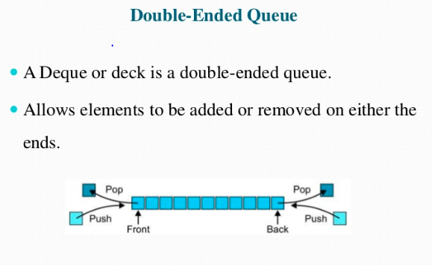

Slide 16
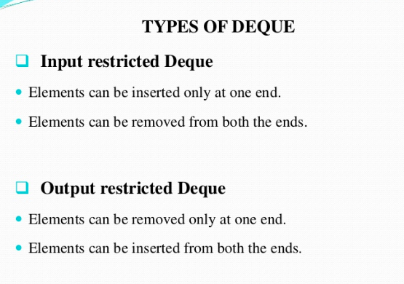

Slide 17
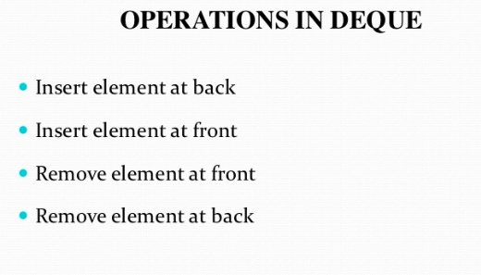

Slide 18
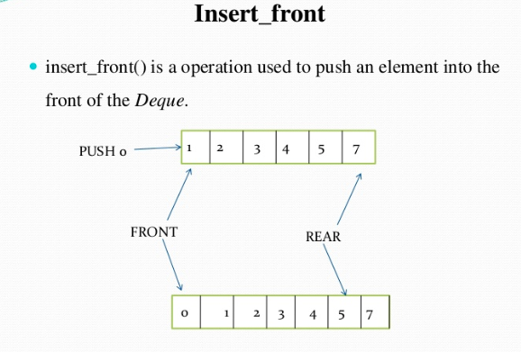

Slide 19
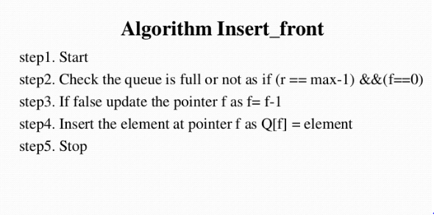

Slide 20
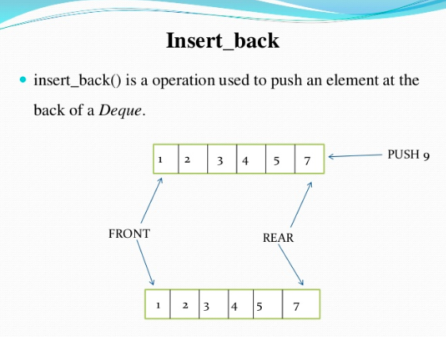

Slide 21
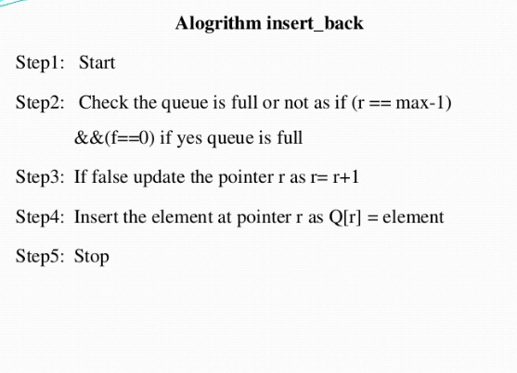

Slide 22
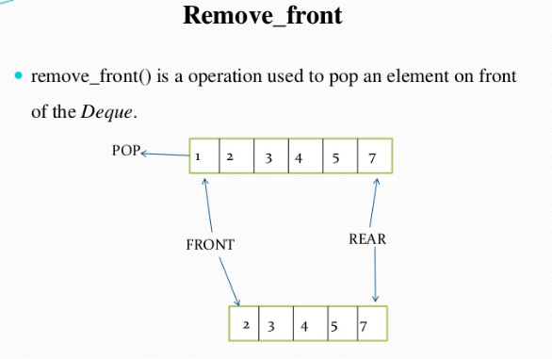

Slide 23
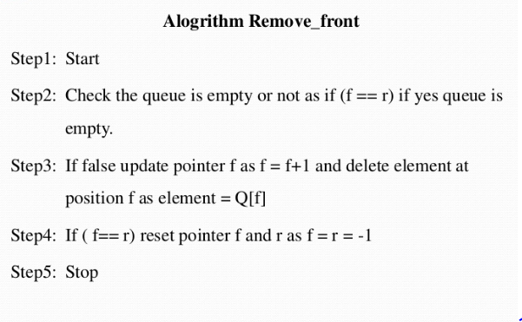

Slide 24
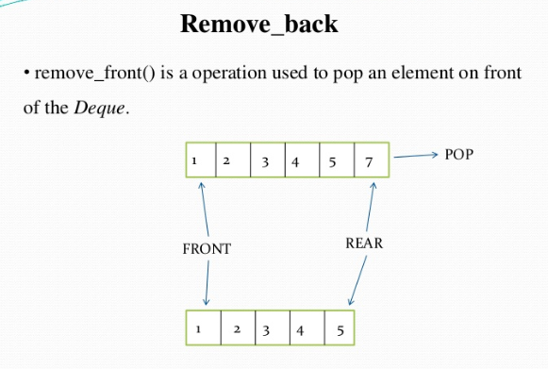

Slide 25
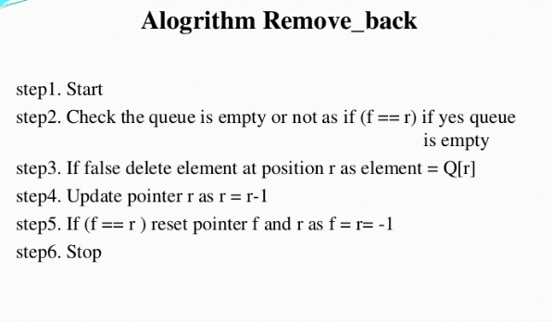

Slide 26
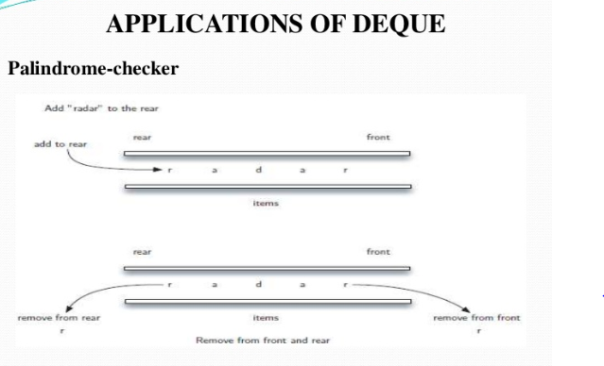

Slide 27
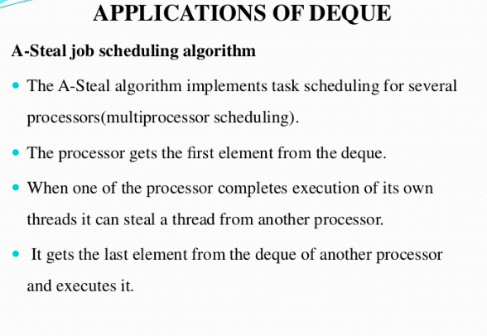

Slide 28
Priority Queue- A priority queue is a collection of elements such that each element has been assigned a priority and such that the order in which elements are deleted and processed comes from following rules:
An element of higher priority is processed before any element of lower priority
Two elements of same priority are processed according to the order in which they were added to queue
An example of a priority queue is a time sharing system. Programs of higher priority are processed first and programs with same priority form a standard queue

Slide 29
One-way list representation of a priority queue
One way to maintain a priority queue in memory is by means of a one-way list
Each node in list will contain three items of information: an information field INFO, a priority number PRN and a link field LINK
A node X precedes a node Y in list
If X has higher priority than Y
Or when both have same priority but X was added to list before Y

Slide 30
Algorithm:LKQINS(INFO,LINK,FRONT,PRN,AVAIL,ITEM, P)
This algorithm inserts an item in linked list implementation of priority queue
Step 1: If AVAIL=NULL,then:
Write: ‘OVERFLOW’
Exit
Step 2: Set NEW:=AVAIL and AVAIL:=LINK[AVAIL]
Step 3: [Enter the data and priority of new node] Set INFO[NEW]:=ITEM and PRN[NEW]:=P
Step 4: Set PTR:=FRONT
Step 5: If PRN[PTR]>PRN[NEW], then
LINK[NEW]:=FRONT
FRONT:=NEW
Return
[End of If Structure]
Step 5: Repeat while PTR≠NULL and PRN[PTR]<=PRN[NEW]
Set SAVE:=PTR
Set PTR:=LINK[PTR]
[End of If Structure]
Step 6: If PRN[PTR]>PRN[NEW]
Set LINK[SAVE]:=NEW
Set LINK[NEW]:=PTR
Else:
Set LINK[SAVE]:=NEW
Set LINK[NEW]=NULL
[End of If Structure]
Step 7: Return

Slide 31
Another way to maintain a priority queue in memory is to use a separate queue for each level of priority . Each such queue will appear in its own circular array and must have its own pair of pointers, FRONT and REAR.
If each queue is allocated the same amount of space, a two dimensional array QUEUE can be used instead of the linear arrays for representing a priority queue. If K represents the row K of the queue, FRONT[K] and REAR[K] are the front and rear indexes of the K^{th} row.
1 2 3 4 5 6
1 AAA
2 BBB CCC XXX
3
4 FFF DDD EEE
5 GGG
Priority

Slide 32
Algorithm: QINSERT( QUEUE,N, FRONT, REAR,ITEM,K)
This algorithm inserts an element in a priority queue in a row with priority
K. N is the size of the K^{th} row.
Step 1:[Queue already filled]
If FRONT[K]=1 and REAR[K]=N or FRONT[K]=REAR[K]+1, then:
Write: ‘OVERFLOW’
Exit
Step 2: If FRONT[K]=NULL, then: [Queue initially empty]
Set FRONT[K]:=1 and REAR[K]:=1
Else If REAR[K]=N, then:
Set REAR[K]:=1
Else:
Set REAR[K]:=REAR[K]+1
[End of If structure]
Step 3: Set QUEUE[K][REAR[K]]:=ITEM
Step 4: Return

Slide 33
Algorithm: QDELETE(QUEUE,N,FRONT,REAR,ITEM, START, MAXP)
This algorithm deletes an element from a priority queue. MAXP is the
maximum priority in the array
Step 1: Set K=1 [Priority number]
Step 2: Repeat while K<=MAXP and FRONT[K]=NULL
Set K=K+1
[End of Loop]
Step 3: If K>MAXP , then:
Write:’UNDERFLOW’
Exit
[End of If structure]
Step 4: Set ITEM:=QUEUE[K][FRONT[K]]
Step 5: If FRONT[K]=REAR[K], then: [Empty Queue]
Set FRONT[K]:=NULL and REAR[K]:=NULL
Else If FRONT[K]=N, then:
Set FRONT[K]:=1
Else:
Set FRONT[K]:=FRONT[K]+1
[End of If structure]
Step 5: Return

Slide 34
References
Dinesh Mehta and Sartaj Sahni Handbook of Data Structures and Applications, Chapman and Hall/CRC Press, 2007.
Niklaus Wirth, Algorithms and Data Structures, Prentice Hall, 1985.
Diane Zak, Introduction to programming with c++, copyright 2011 Cengage Learning Asia Pte Ltd
Schaumm Series ,McGraw Hill.

